Slide 1


Slide 2
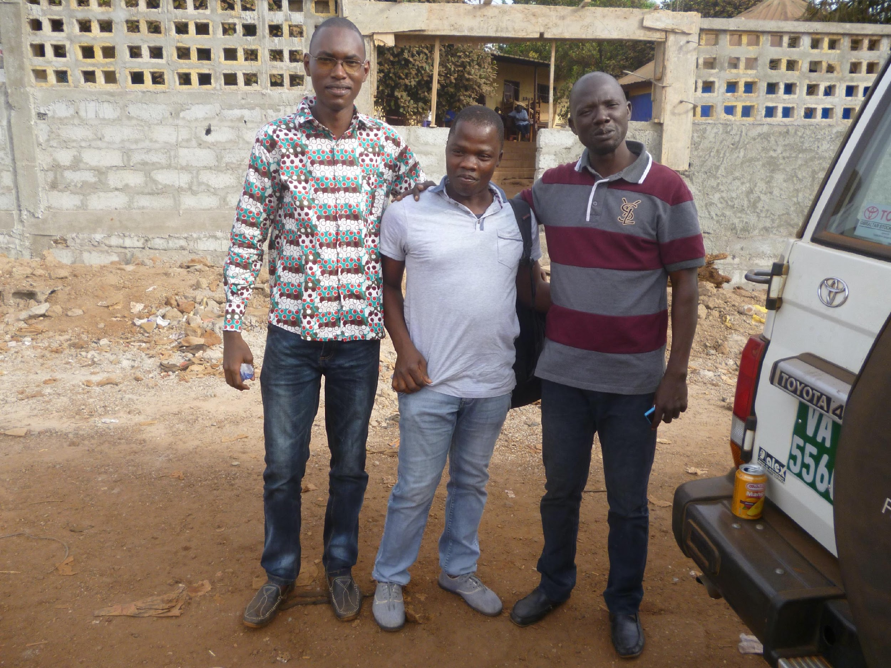
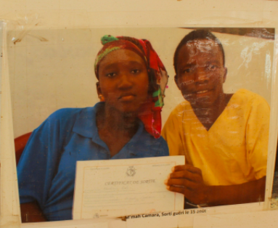


Mistrust and struggle from some participants

Slide 3

Perceptions and moral experiences of Ebola research
Some didn't realize they'd been part of a study
Unsure of compensation standards = anger and rumors
Results not shared
"They called us guinea pigs!

Slide 4

Scientific and social value of research is essential, but not enough
We must respect the participants, their rights, their well-being, and that of their communities.
Ethical research is research with good community involvement, to ensure acceptable projects and approaches, and understanding of research objectives and procedures.

Slide 5
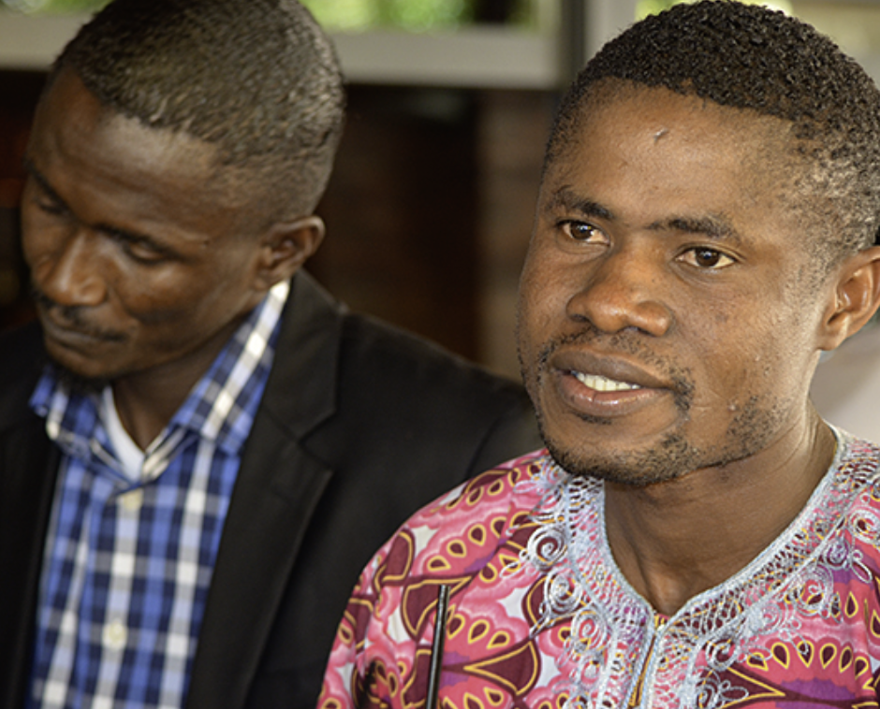

Suggestions from Ebola survivors/ex-participants?

Slide 6


Development of the Toolbox

Slide 7









Réseau national
des associations de survivants guéries d’Ebola de la Guinée
RENASEG
FOSAD
Health & Sustainable Development Foundation
Comité National D’Ethique de la Santé de Guinée
SLAES
Sierra Leone
Association of
Ebola Survivors

Slide 8
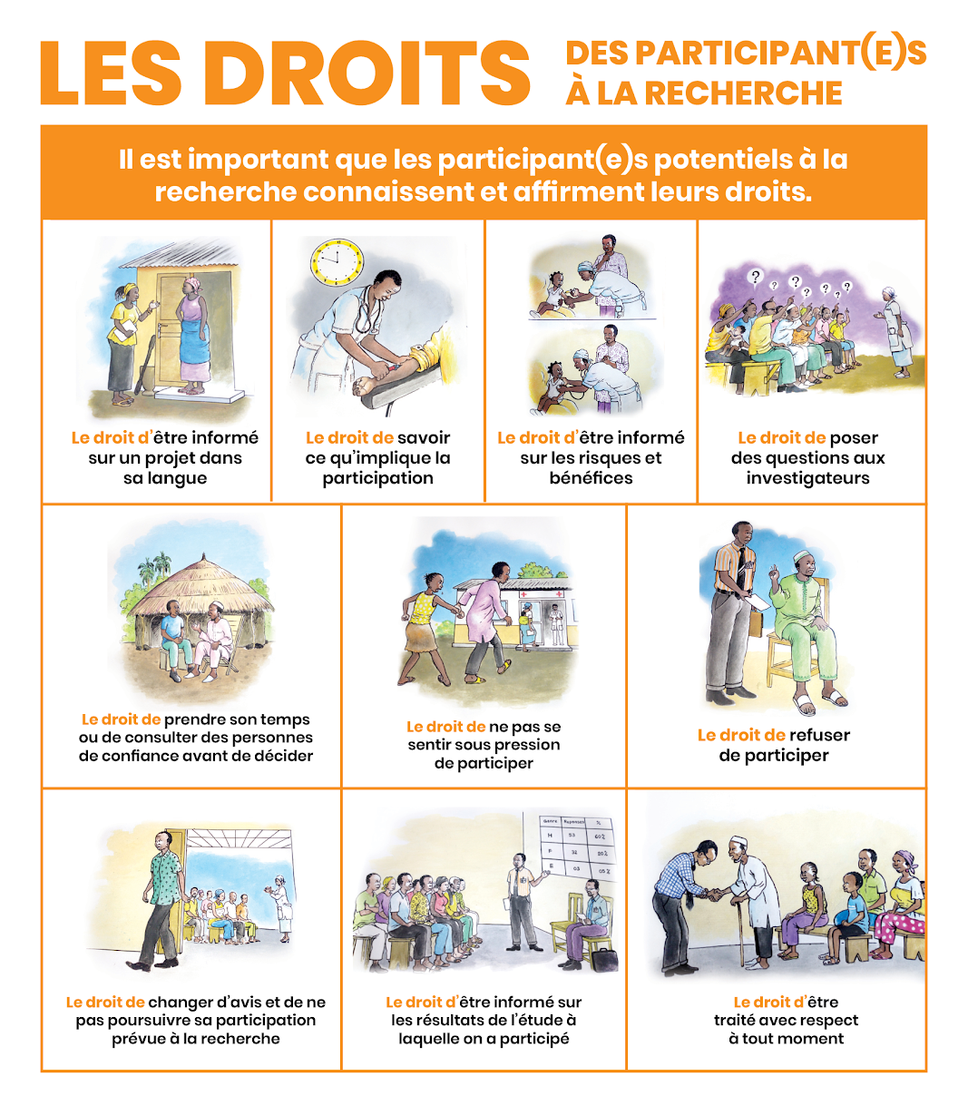

Slide 9
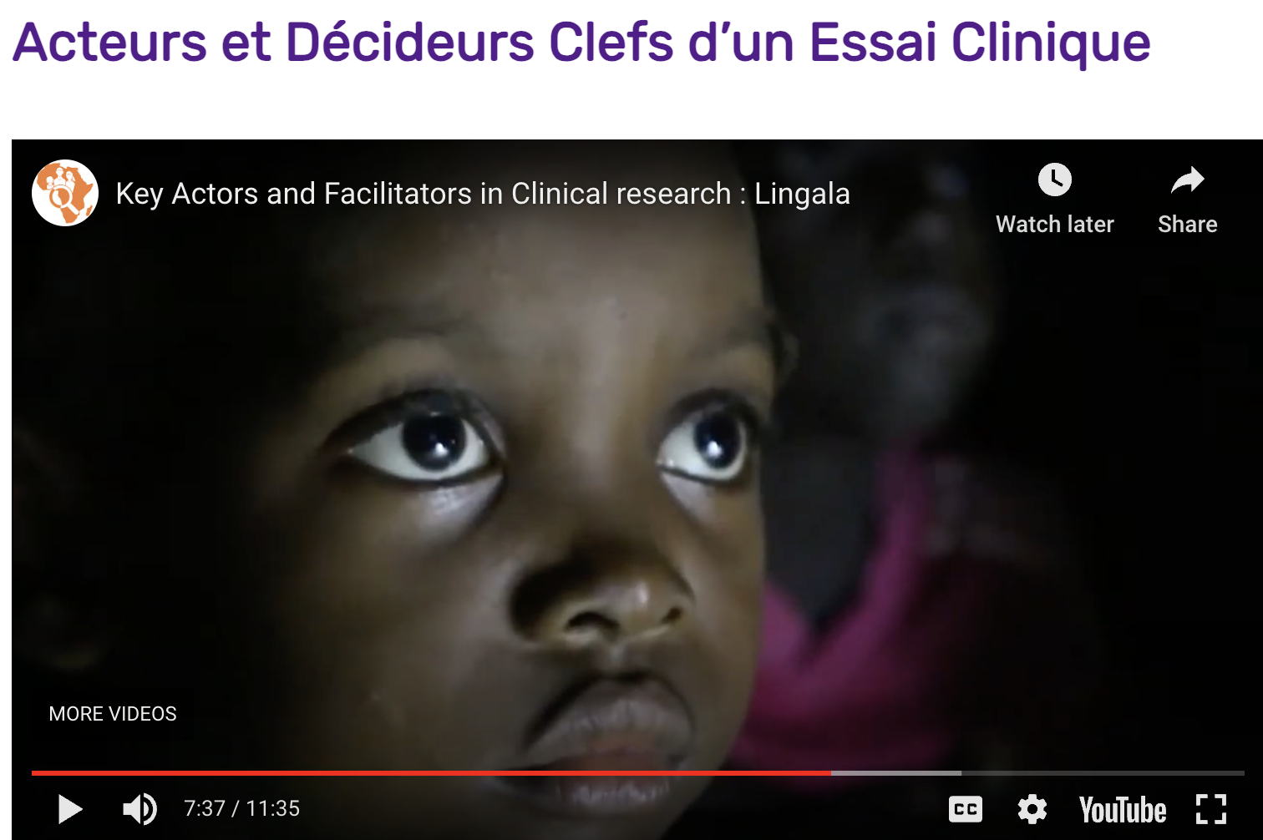
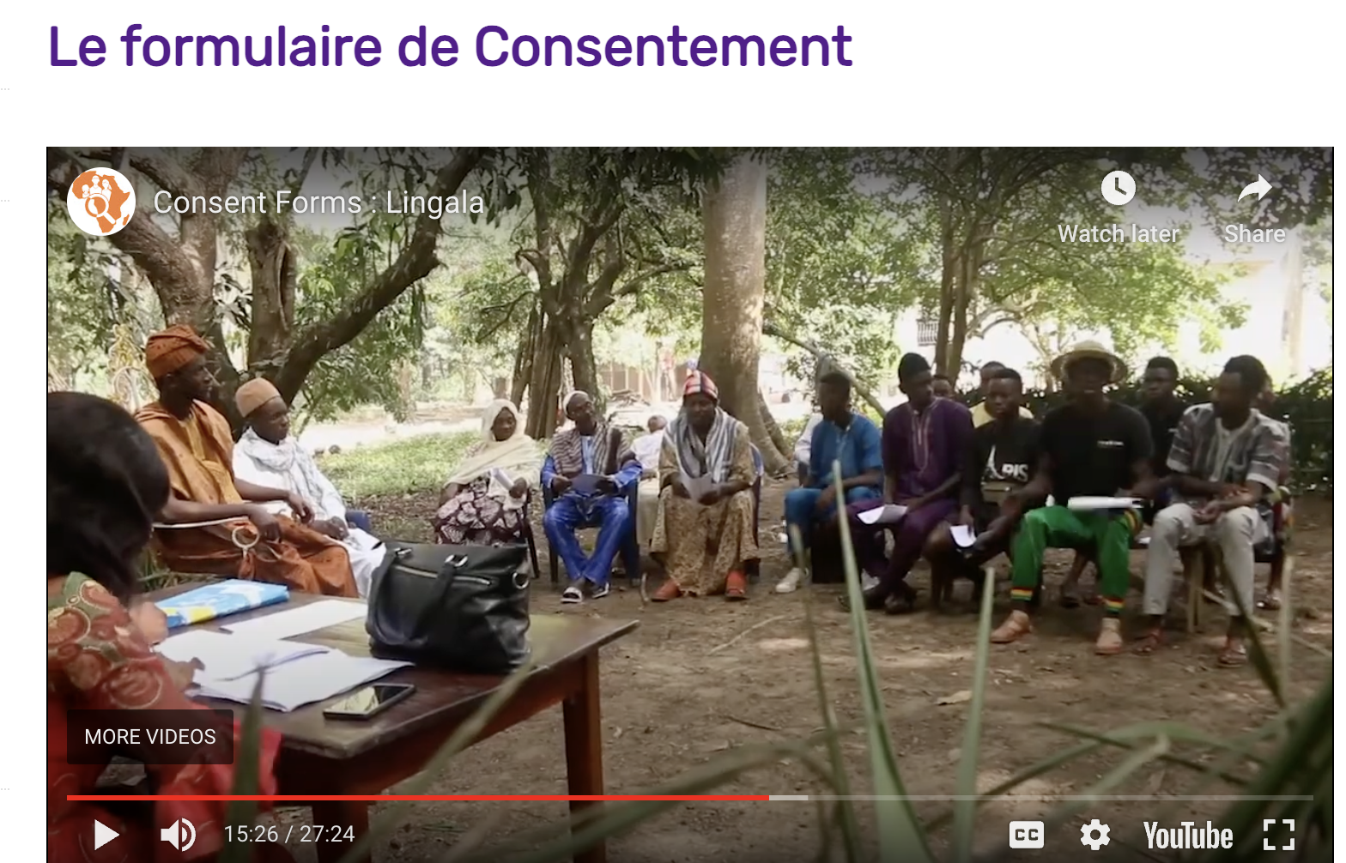
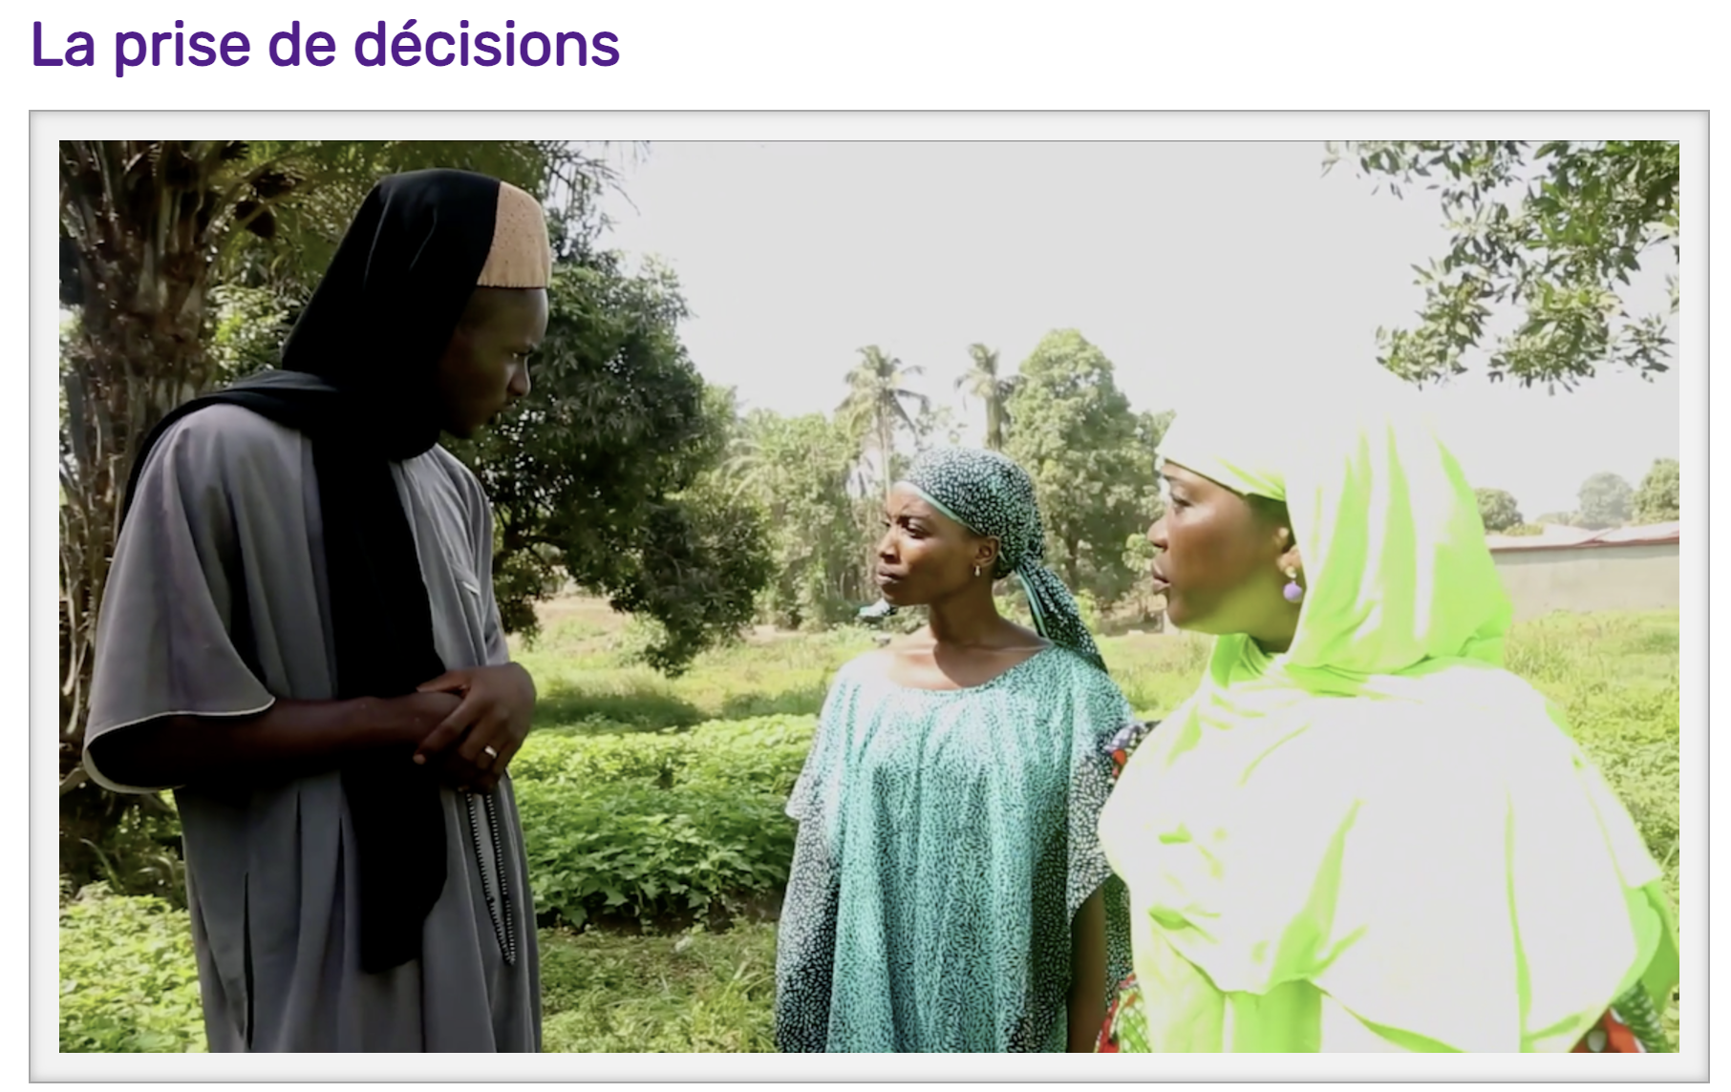
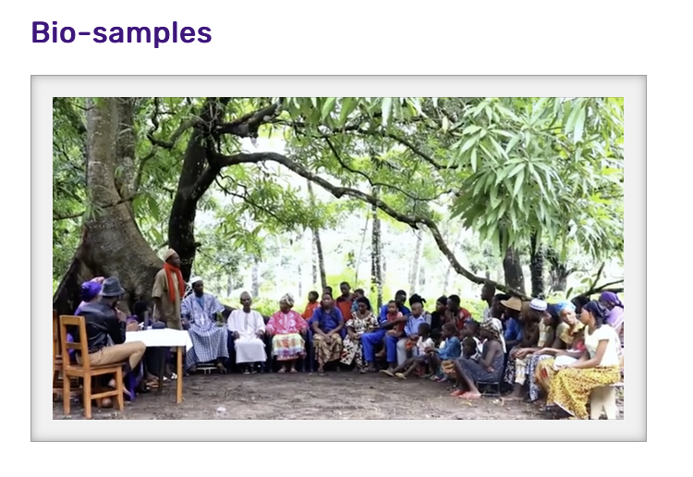
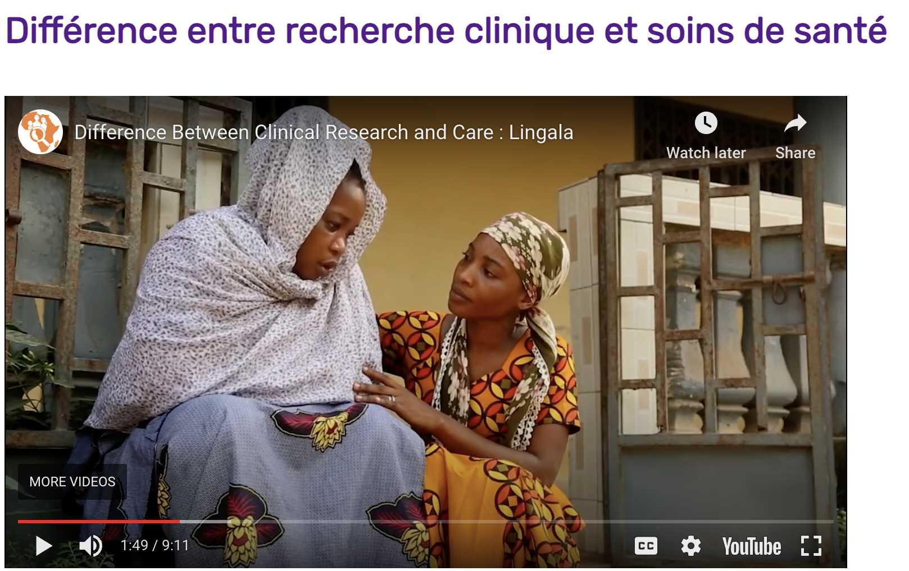
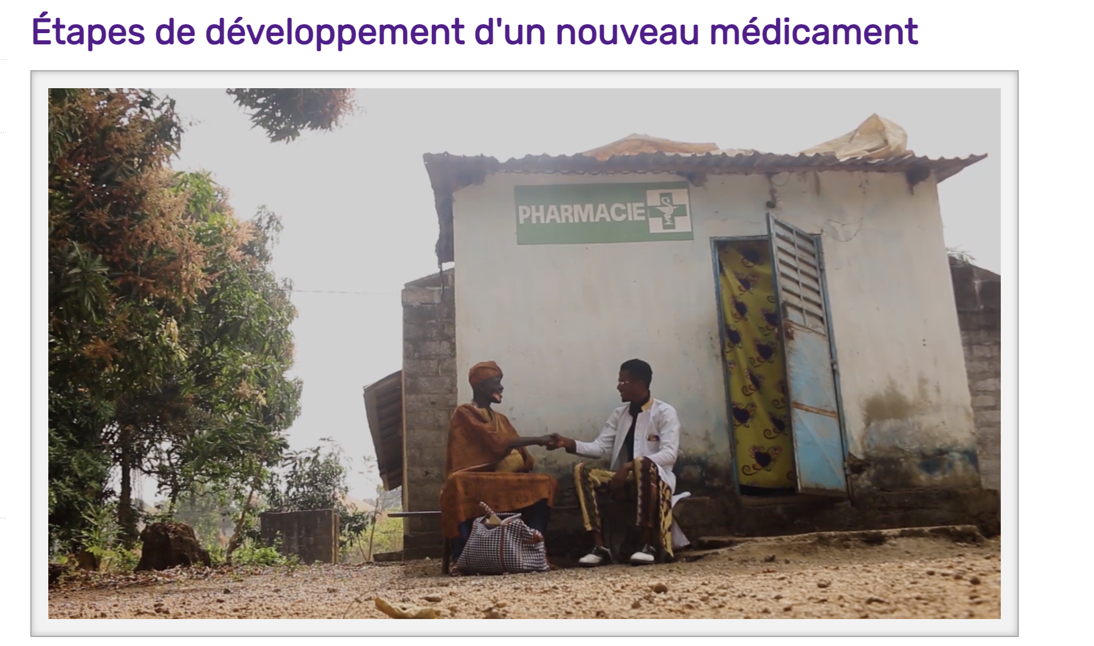

Slide 10

Free access and videos in 6 languages
Lingala
Malinke
Soussou
Kiswahili
English
French

Slide 11
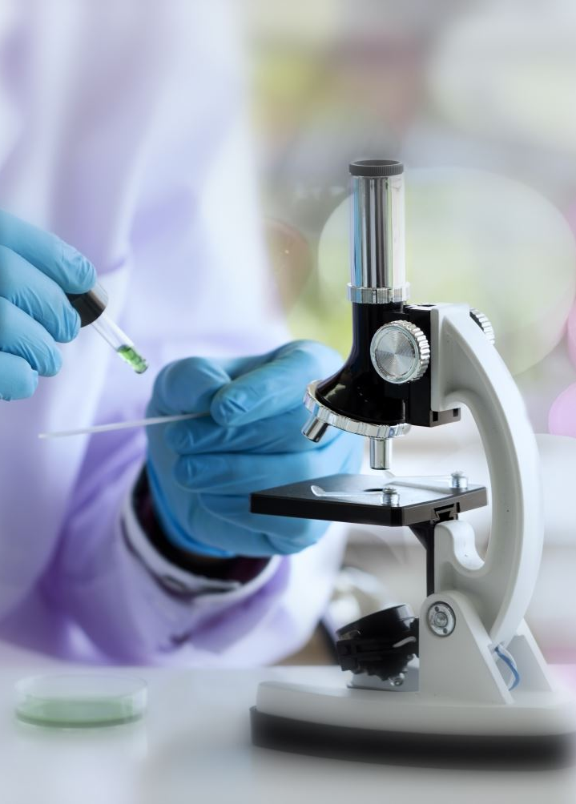
7 themes
Participants' fundamental rights
The difference between healthcare and health research
Stages of drug development
Key players and decision-makers in a clinical trial
Decision-making
Bio-samples
The consent form

Slide 12
Workshop objectives:
Training community leaders: Research, participants' rights, the Toolbox
Strengthening and exchanging knowledge between network members CONERELA+
Feedback: can these tools be of use to you and the DRC?
Notes:
Quelles limitations percevez-vous, pour utilisation dans votre communautés? Quelles questions / dialogue additionnels sont recommandées pour optimiser l’utilité de certains outils en RDC?
, vis à vis le risque aux members de la communautés vécus ou possibles des projets de recherche Mpox

Slide 14

How many of you have already taken part in a clinical study?
How many of you have already helped to find participants for a study?
Have any of you already taken on other roles?

Slide 15
Scenario
You learn that a new team of researchers, possibly from the Red Cross, are looking for high-risk Mpox participants in your community.
You hear it from the women at the market.
What pops into your head?
What hopes, questions, fears or other thoughts do you have?

Slide 16
Working in groups (15 min)
01
02
How do you determine whether a study is good for your community? What actions or factors must be present for you to trust a study?
What could cause you to lose confidence in a study or its researchers?
Notes:
Comment determinez-vous qu’une étude est bonne pour votre communauté? Quelles actions ou facteurs doivent etre present pour que vous fassiez confiance à une étude?

Slide 17
If you are a community focal point for a study, and some members of your community are dissatisfied or angry after the study, how can this affect you?

Slide 18
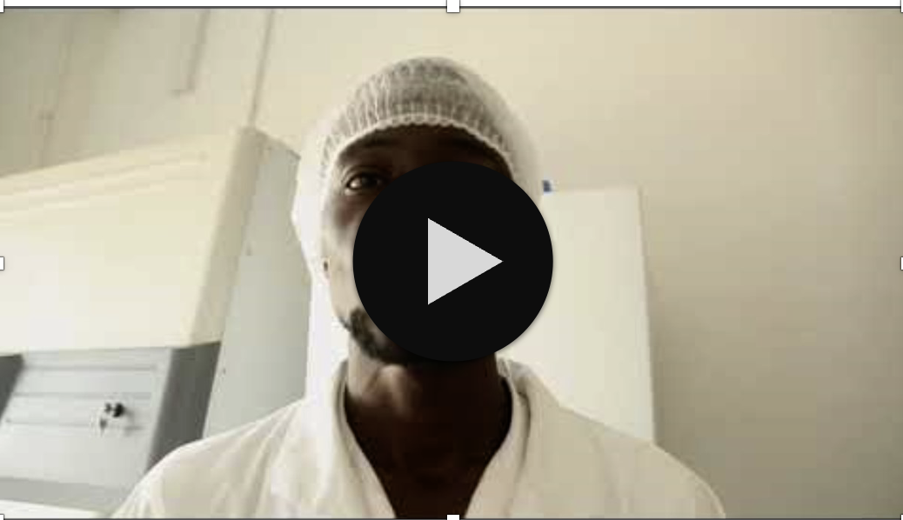
The difference between clinical research and healthcare (11 min)
Notes:
Qu’est-ce que vous en pensez
Est-ce que vous avez ete confronte a ces realites

Slide 19
Discussion (10 min)
1. How did you find the video?
2. Do you think this could be useful for your community?
3. Who in your community would benefit from seeing this film?

Slide 20
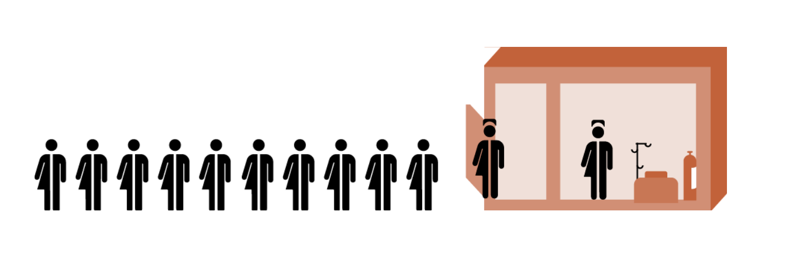
Discussion… (5 min)
Have you ever been ill?
When you were ill: how were you treated?
Did you have access to medication?
Do you know how to obtain medication?

Slide 21
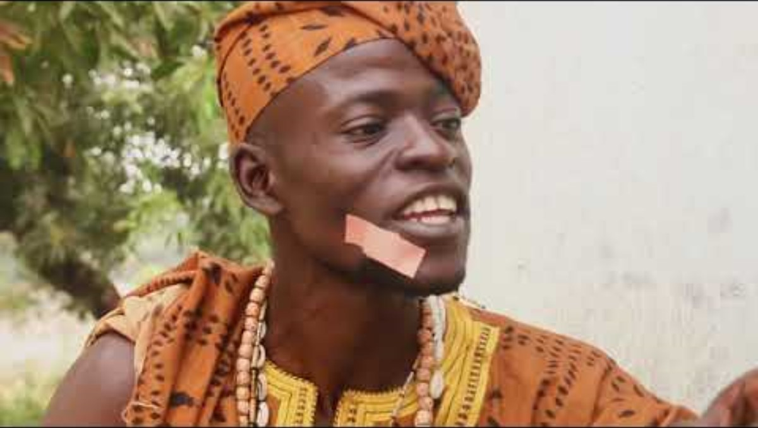
Stages in the development of a new drug
(12 min)

Slide 22
Discussion (10 min)
Do you still have questions about drug development?
Does it help if the steps involved in manufacturing a drug are respected?
Do you think this film is useful for your community?

Slide 23

Coffee Break

Slide 24
Practical group scenario (15 min)
Researchers come to your community to test a new malaria treatment
They want your help in recruiting participants.
Do you agree?
Do you have any questions?
Which questions?

Slide 25
Discussion: Research ethics and participants' rights (10 min)
What do you think research ethics are all about?
2. Do participants have any special rights?
3. Do you think it's important to respect these rights?
4. Can you name a few rights in research ethics?

Slide 26
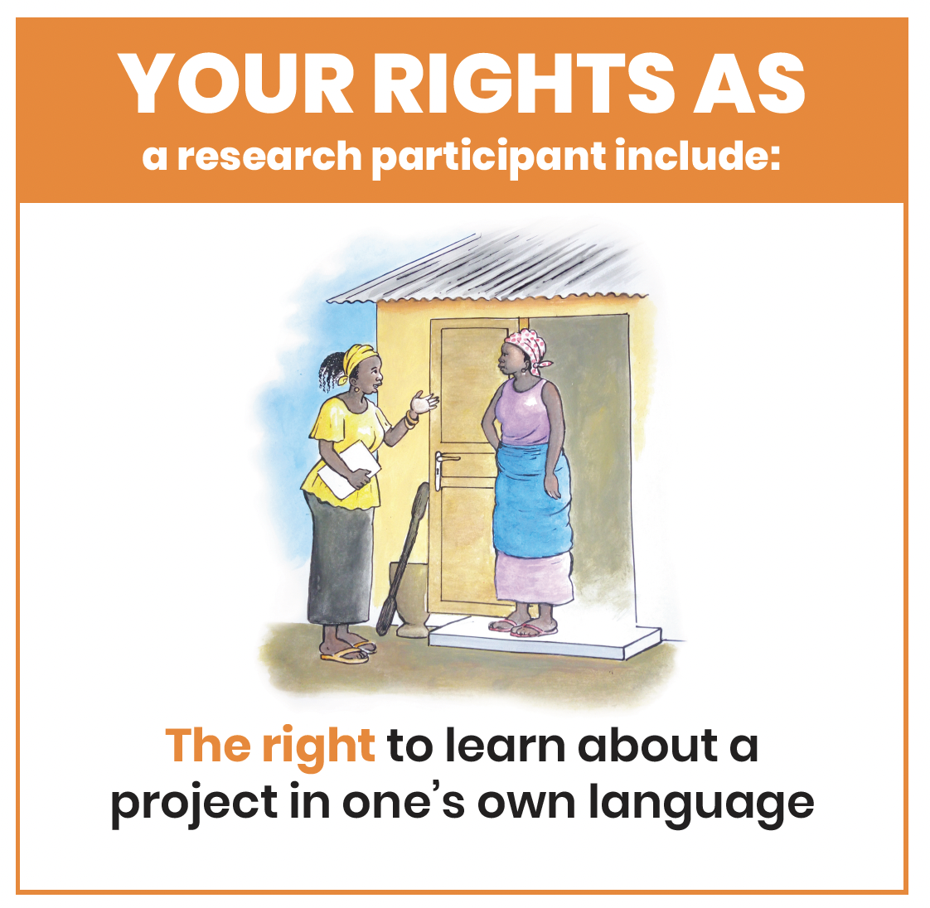

Slide 27
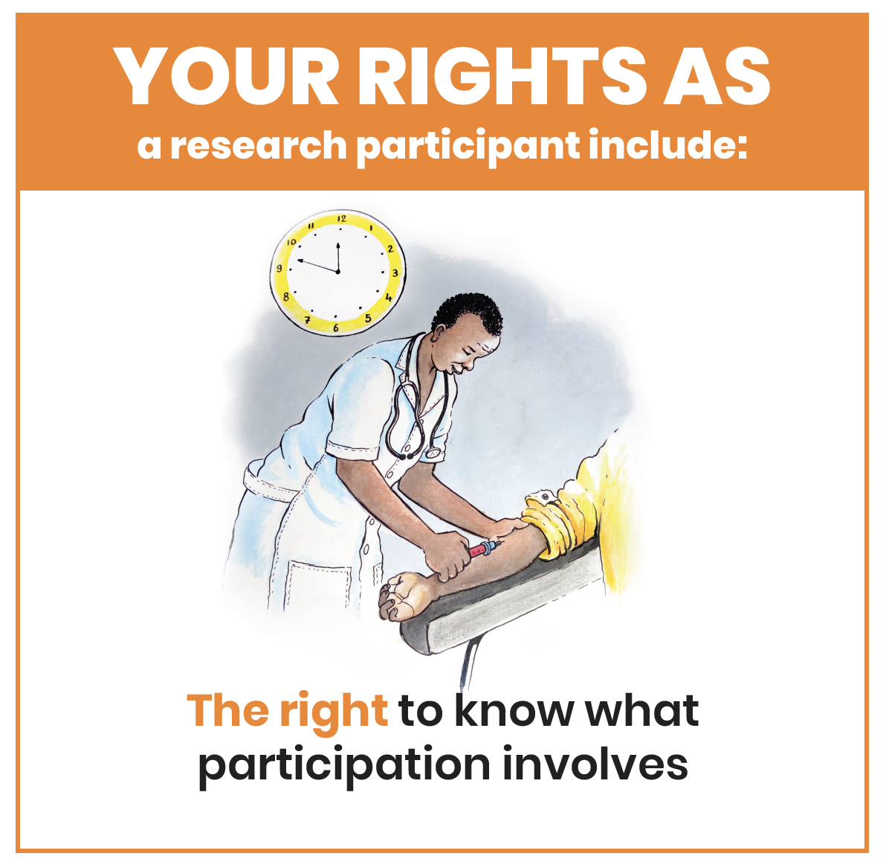

Slide 28
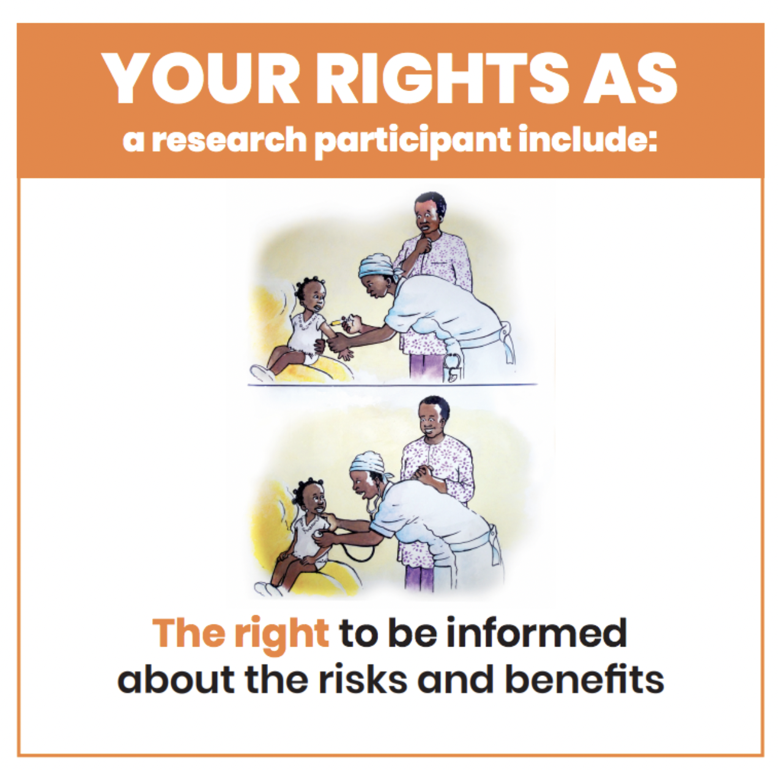

Slide 29
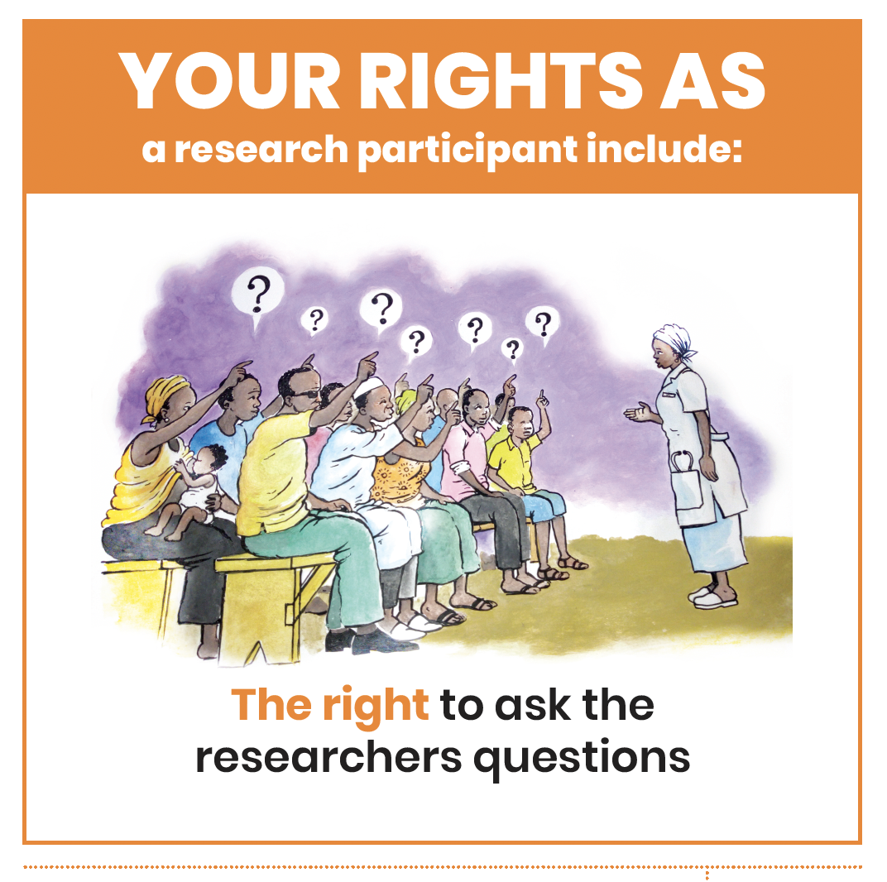

Slide 30
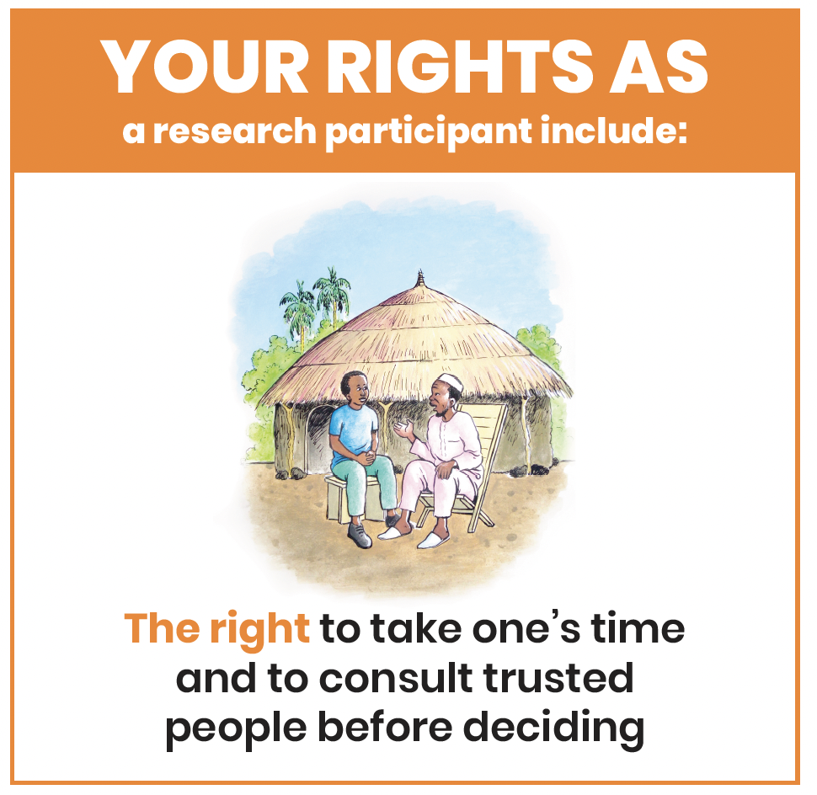

Slide 31
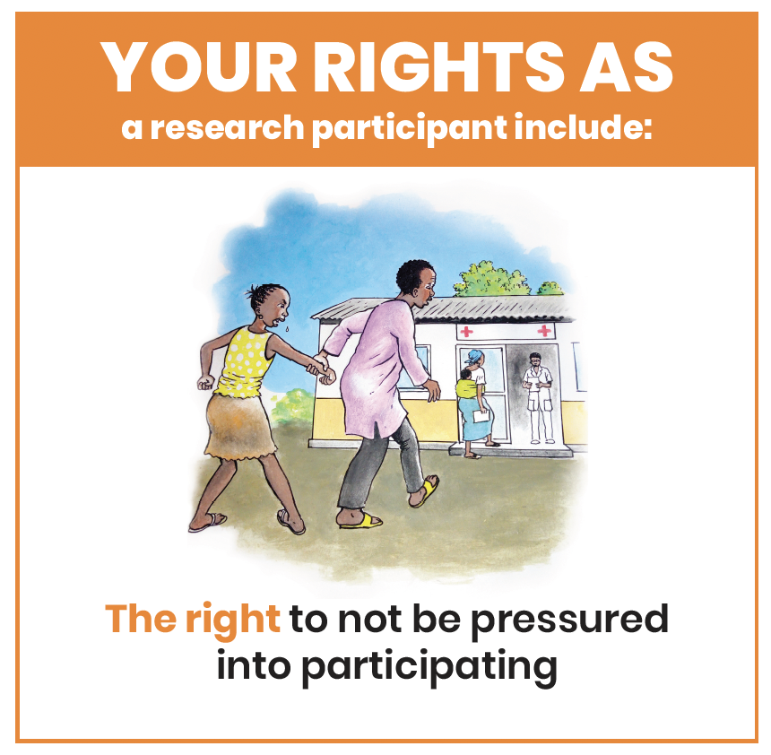

Slide 32
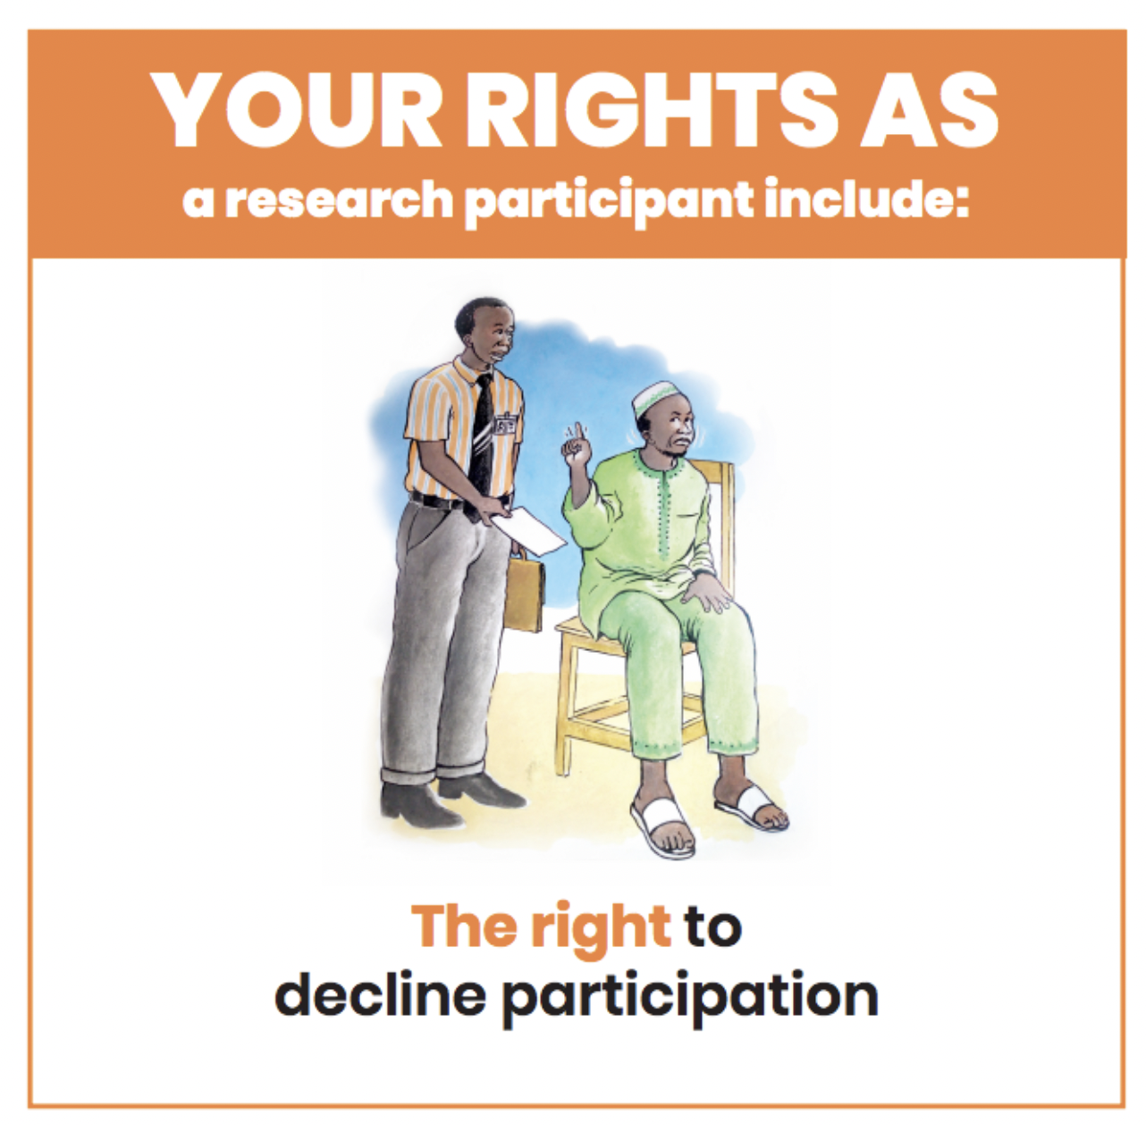

Slide 33
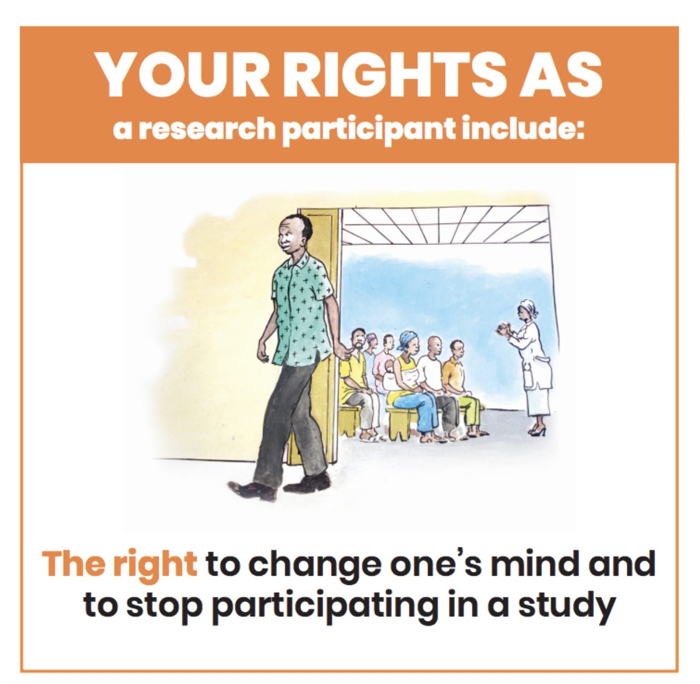

Slide 34
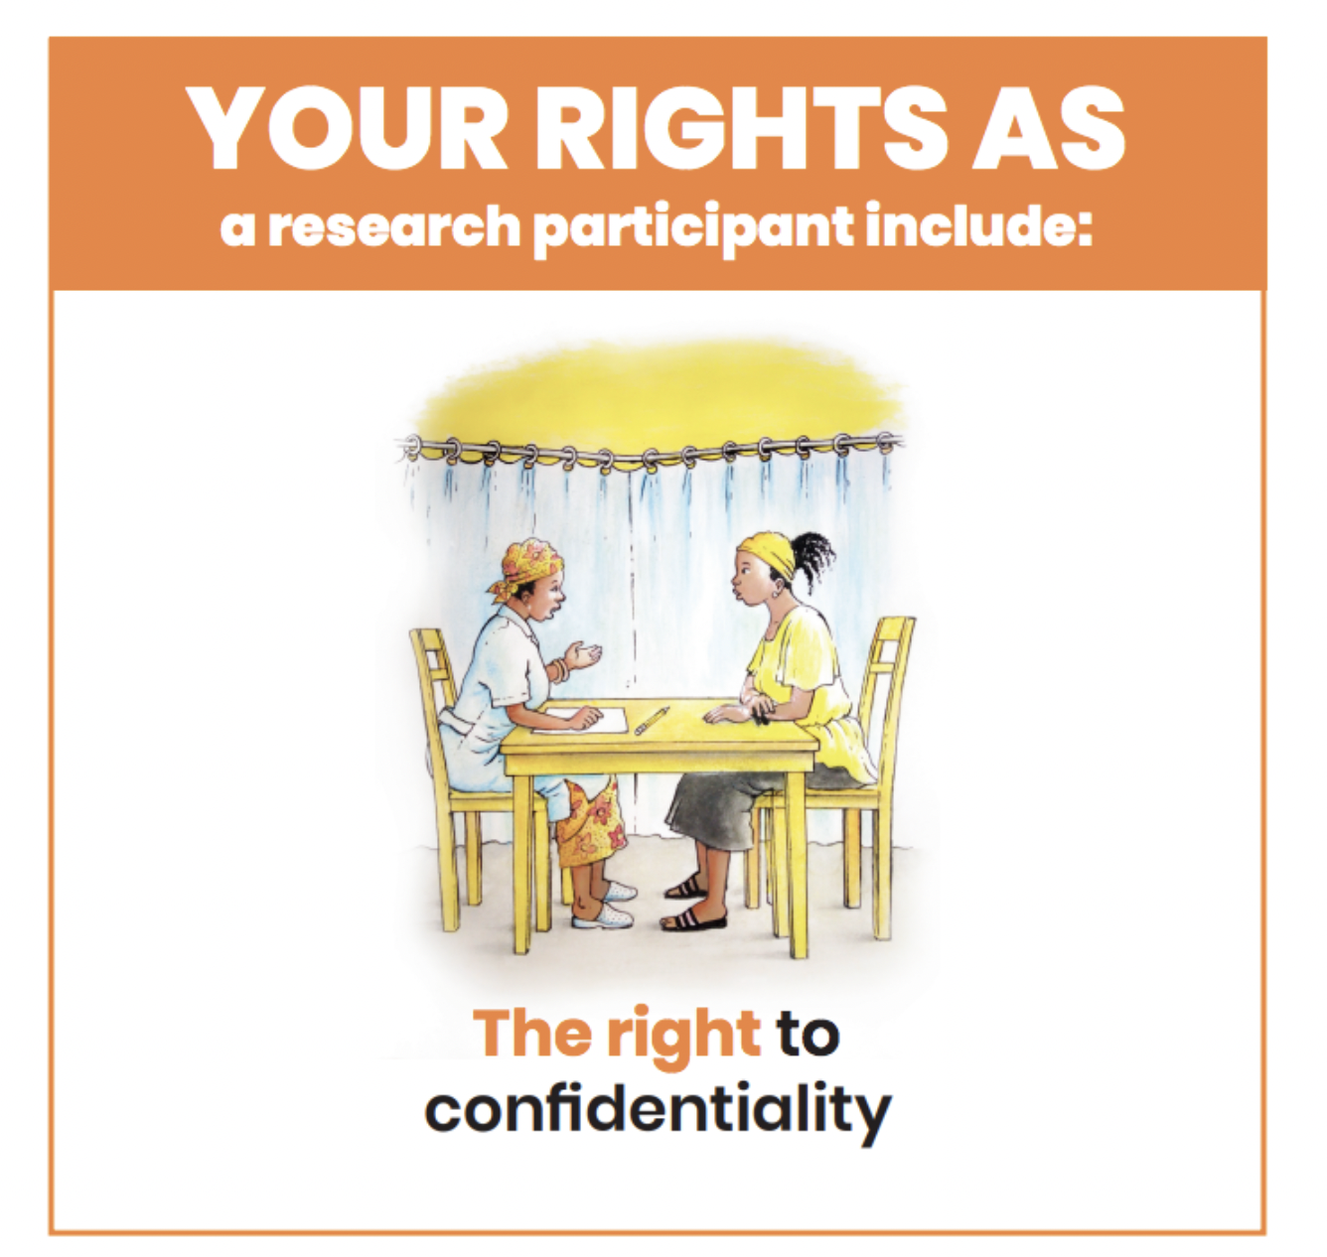

Slide 35
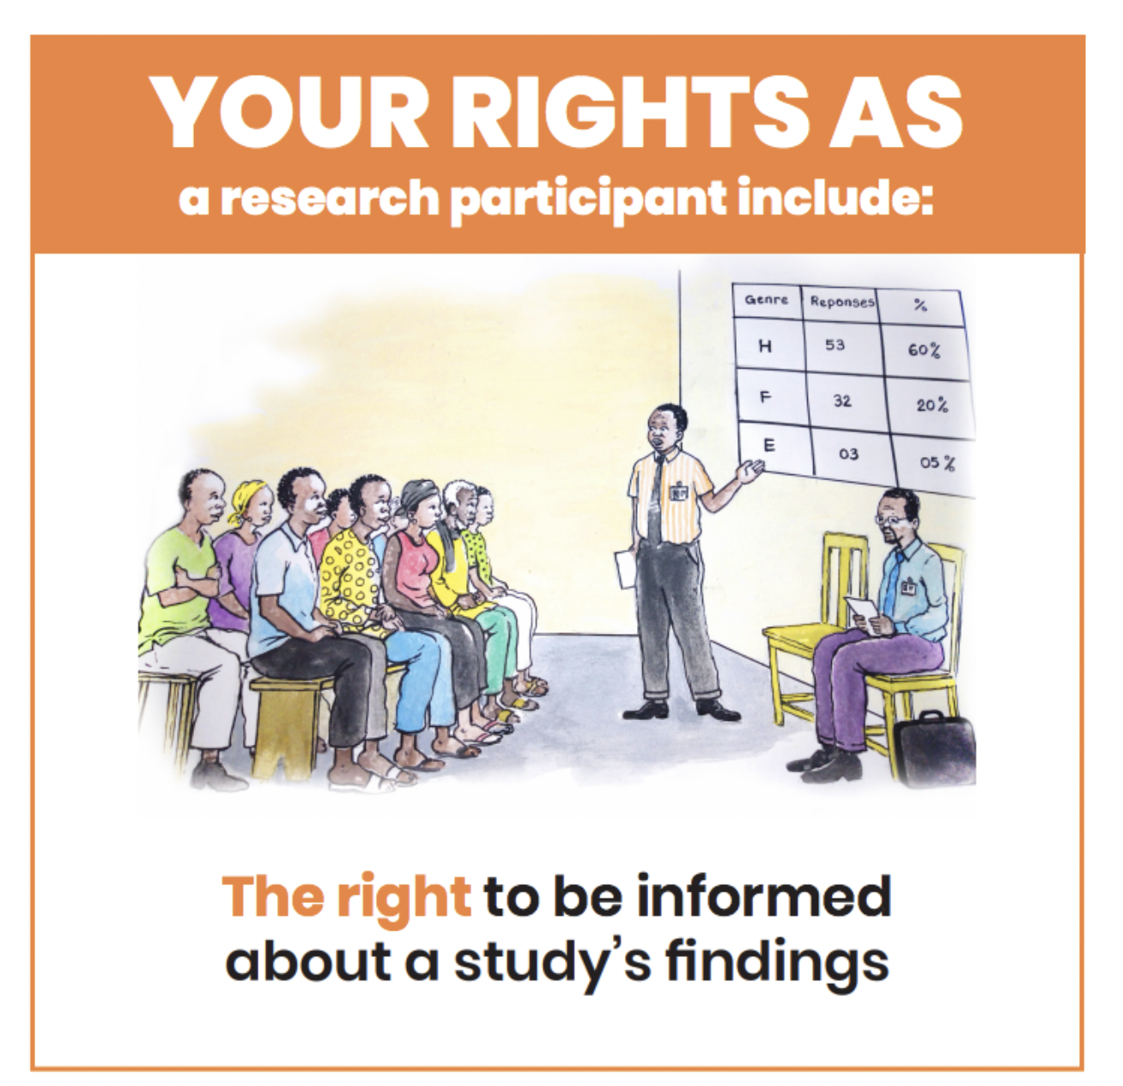

Slide 36
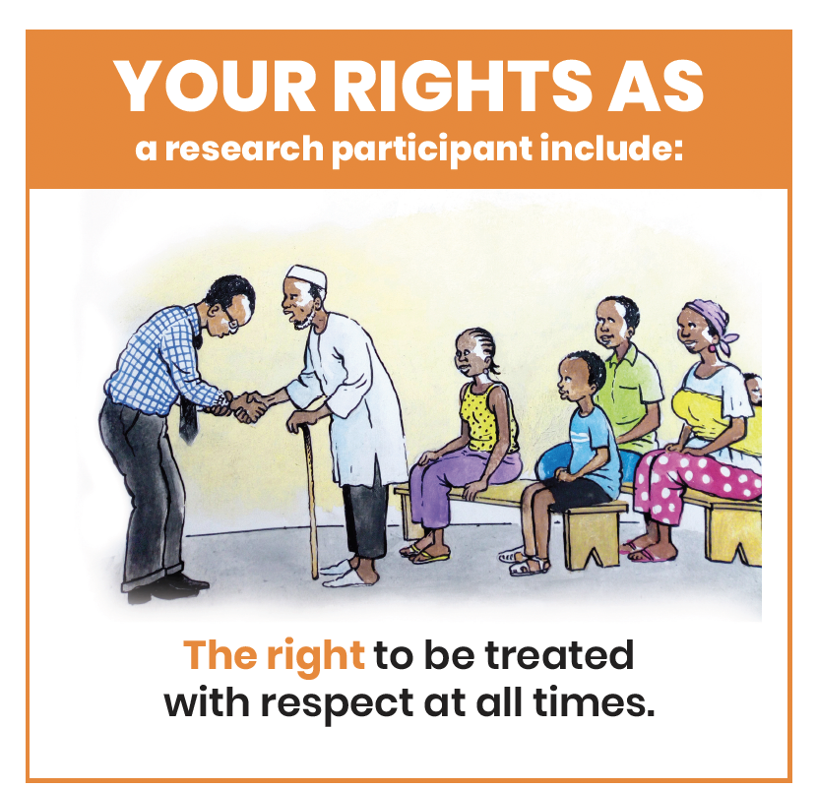

Slide 37
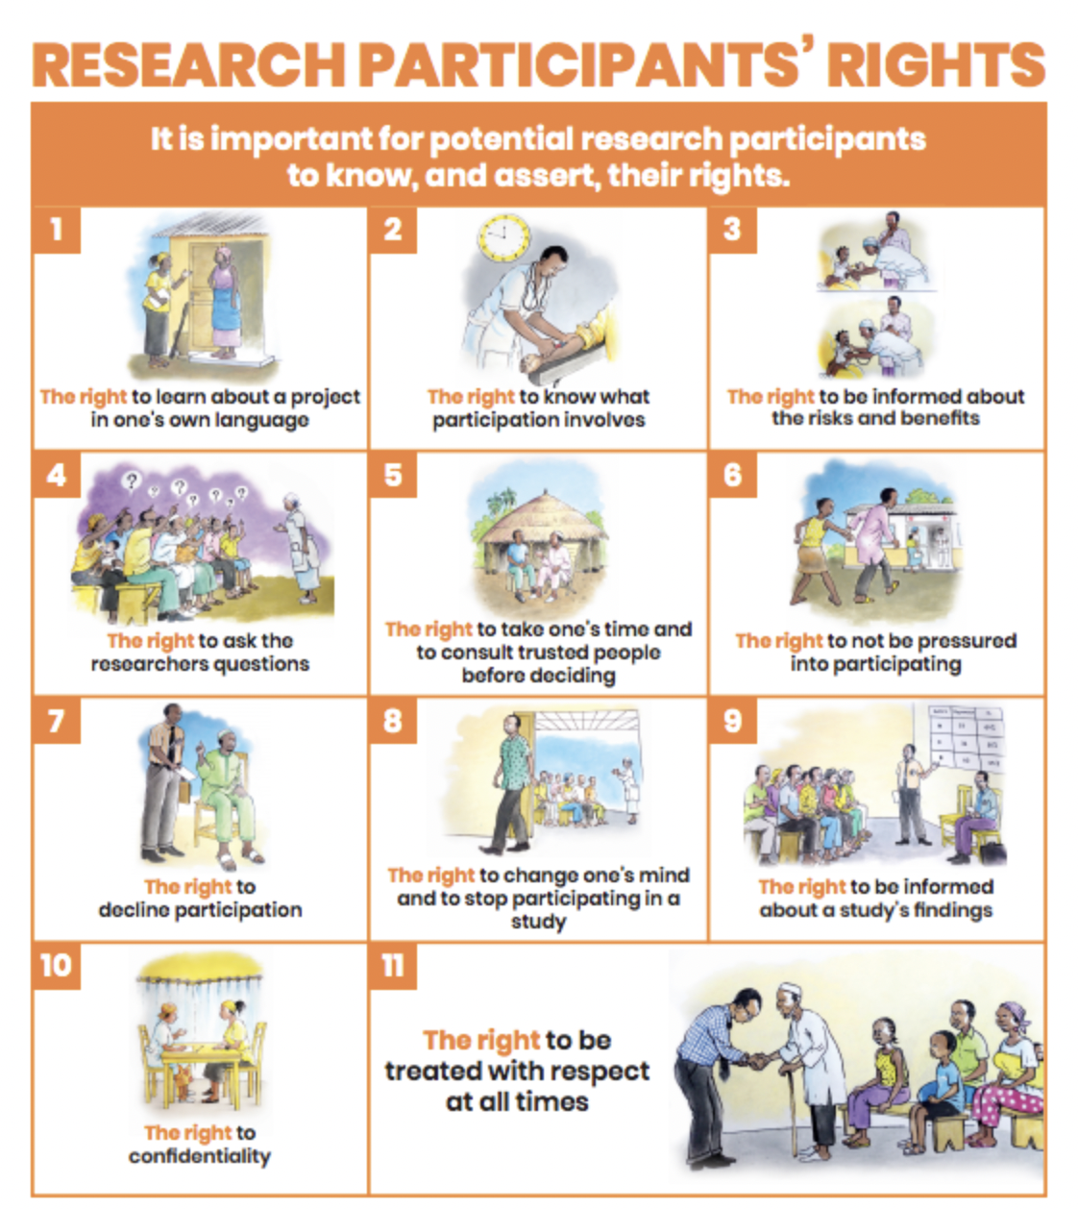

Slide 38
Discussion (30 min)
Which of these rights do you think are less respected in your community?
What contributes to this situation?
Does the absence of this right trouble you too much or not at all?

Slide 39


Photo+ Lunch

Slide 40



The decision to participate in research
ROLE-PLAYING GAME
2 SCENARIOS + DISCUSSIONS
VIDEO: TO PARTICIPATE OR NOT?

Slide 41
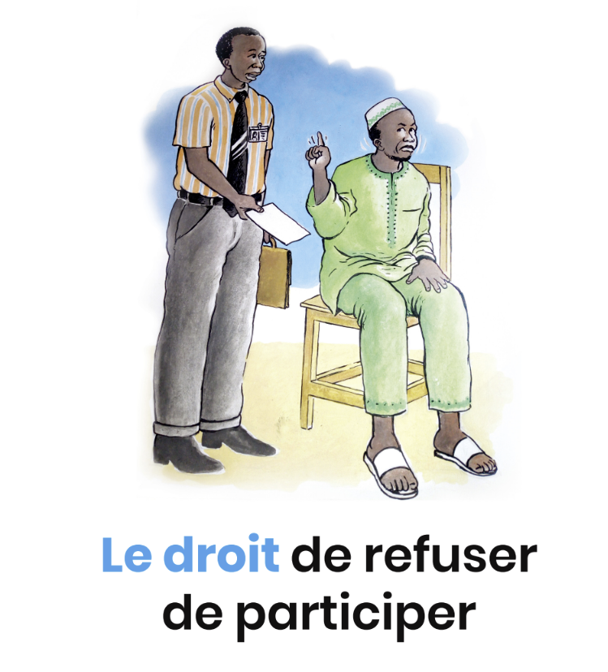
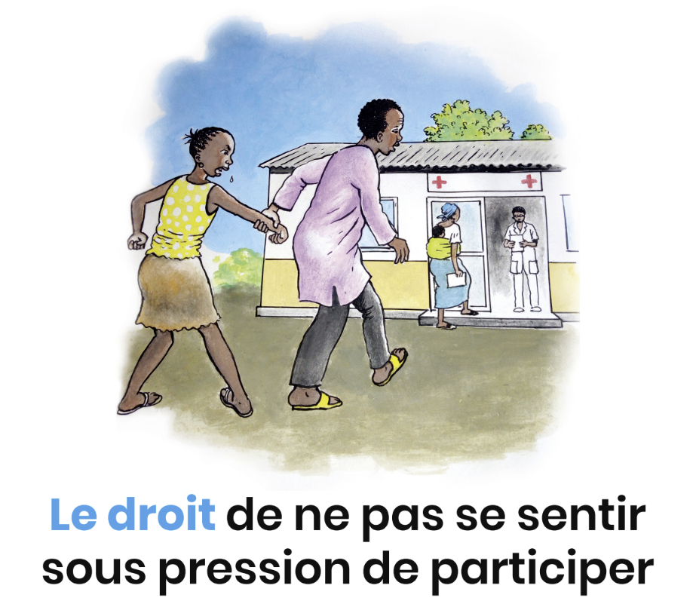

Slide 42
Discussion (10 min)
Is it really essential for every adult to decide for themselves whether or not to take part in a study?
Are there any advantages to having the head of the family or community recommend a decision to others?
What are the disadvantages of this? (disadvantages for whom?)

Slide 43
Role-playing game – 2 scenarios (45 min)
We form 2 Groups
2 groups of 3 people
1 group of 14 people
Assigned scenarios
Each person in the group chooses their role and must be prepared to show or tell their character's point of view.
ACTION: The group improvises its scene
(adapt activities pages 54-55 facilitator's guide)

Slide 44
Role-playing - Role division / preparation (10 min)
Two sisters/brothers chat. Another family member arrives, announcing that he's just been told about a study looking to recruit people who've never had Mpox to test a new Mpox treatment.
1 character should support participation
1 other must be uncertain/challenging.
A local chief introduces a researcher who wants to initiate a vaccine trial for Mpox sufferers in the area.
The local chief seems to be in favor of the trial.
Some don't trust (the chief? The researcher? Other?), or are afraid of.
Some think it's a good opportunity.

Slide 45

Action! (5-7 min each)

Slide 46
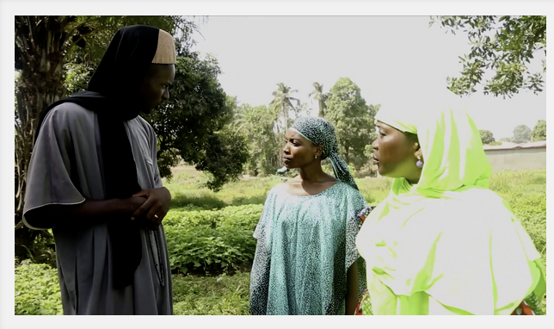
Decision-making (Lingala 7 min)

Slide 47
You are free…
To take your time
To discuss/reflect with family and friends
Often, in addition to national acceptance of the study, community consent is required before participants can be sought in a community.
Everyone has the right to decide for themselves whether or not they want to participate.

Slide 48
Coffee Break

Slide 49
Discussion bio-samples (10 min)
What do you think bio-samples are used for in research?
Have you witnessed blood or other biosamples being taken during a study and what was your reaction?

Slide 50
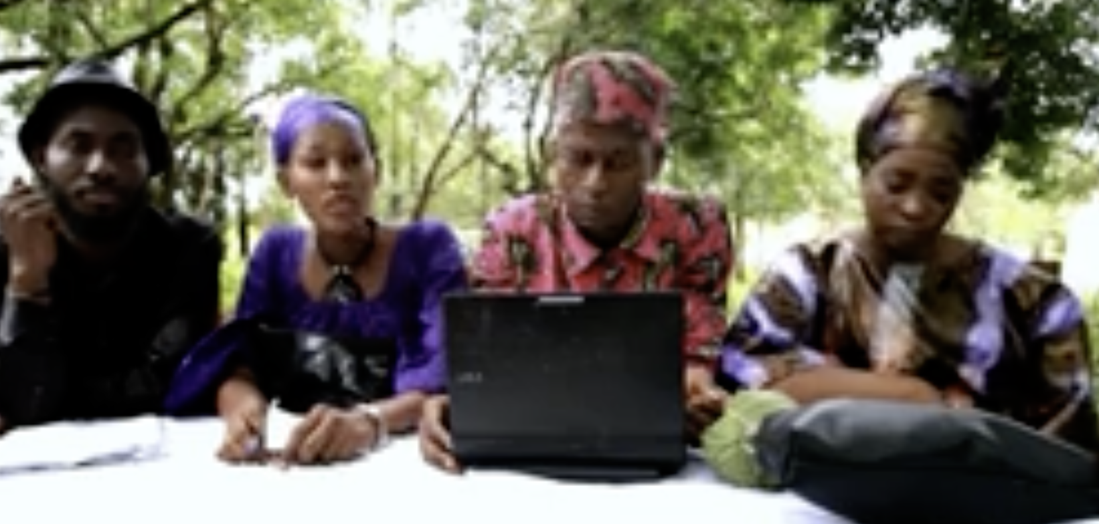
Bio-samples (17 min)

Slide 51
Post-Film Discussion (10 min)
Does the scenario seem realistic to you?
2. Do you find this film useful to share and discuss with others?
3. Other thoughts?
- page 69 of the Facilitator's Guide, Activity 1, suggests that you and your community identify the questions you would like to ask the researcher.

Slide 52

Questionnaire Please help us understand how you found the workshop 15 min

Slide 54
Final Thoughts
In your opinion, can this toolbox be useful in communities to inform/raise awareness?
Now it's up to you to take action by using the toolbox for future research.

Slide 55

Thank you!

